Slide 1
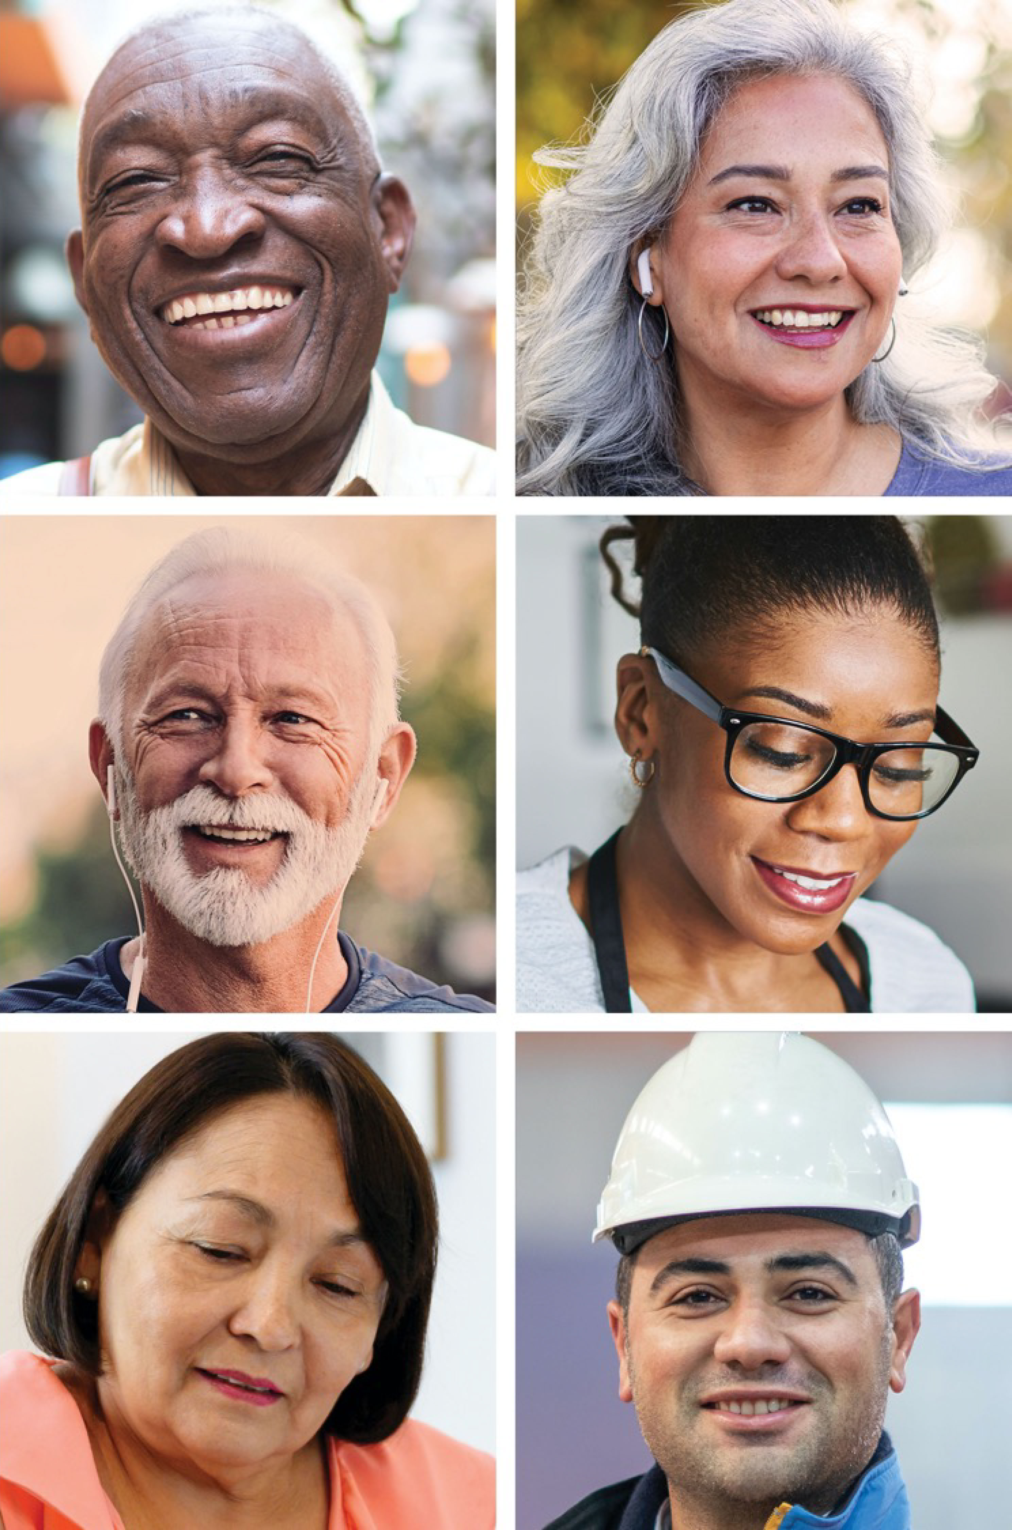
NIH CEAL Content Toolkit
Last updated 2/10/2021

Slide 2
About This Toolkit
The NIH Community Engagement Alliance (CEAL) Against COVID-19 Disparities focuses on addressing misinformation around COVID-19, engaging trusted partners and messengers in the delivery of accurate information, and educating communities on the importance of inclusion in clinical research to overcome COVID-19.
This toolkit, which is distributed monthly, include infographics, videos, toolkits, social media and key digital links that you can share with your communities to help keep them informed. This February edition includes a Journey of a Vaccine infographic, clinical trial and vaccine education videos, and CDC COVID-19 toolkits for community-based organizations and essential workers on Slides 5 – 7. Social media content recommendations are on Slides 9 – 18.
All of these resources are also available on the CEAL website at covid19community.nih.gov
Content Guide
For vaccine education materials, see Slides 5-7, 9-14, 15, 16 and 18.
For clinical trials and/or the importance of diversity materials, see Slides 5-6 and 11-18.

Slide 3
Key Digital Resources
NIH CEAL Websites #NIHCEAL
English | Spanish
https://covid19community.nih.gov/ | https://covid19community.nih.gov/espanol
COVID-19 Related Websites
#ConquerCOVID19 • #COVID19
English | Spanish
NIH COVID-19 https://covid19.nih.gov/ | NIH COVID-19 https://salud.nih.gov/
HHS Combat COVID https://combatcovid.hhs.gov/ | HHS Combate COVID (en español) https://combatecovid.hhs.gov/
NIH CEAL Event Calendar https://covid19community.nih.gov/events
NIH CEAL eNewsletter Subscription https://go.usa.gov/xAsax

Slide 4
Featured Content
The following content – Journey of a Vaccine infographic, clinical trial and vaccine educational videos, and CDC COVID-19 toolkits for community-based organizations and essential workers – is available to help educate your stakeholders and answer some of the questions they may have. The content can be placed on your communication channels including newsletters, websites, and social media.

Slide 5
Journey of a Vaccine Infographic
This infographic summarizes how a new vaccine is developed, approved, and manufactured. Share it with audiences who need easy-to-understand information about the clinical research process and have questions about vaccine safety or equity.
Promotional Text to use for Website, Newsletter or Social Media
Learn about the four phases of clinical research, what questions researchers try to answer in each, and how a vaccine is developed, approved and manufactured.
Download Images
View and/or download English image and Spanish image. View and download English and Spanish sets of images optimized for social media.

Slide 6
Clinical Trial & Vaccine Educational Videos
These videos, created by the National Library of Medicine, offer informative facts about clinical trials and vaccines. Each video is available in English and Spanish, and topics include:
English | Spanish
What is a clinical trial? | ¿Qué es un ensayo clínico?
Should I participate in a clinical trial? What’s in it for me? | ¿Debería participar en un ensayo clínico? ¿De que puedo beneficiar?
What should I know to participate in a clinical trial? | ¿Qué debo saber para participar en un ensayo clínico?
What is a vaccine? | ¿Qué es una vacuna?
How are vaccines tested? | ¿Cómo se prueban las vacunas?

Slide 7
CDC COVID-19 Toolkits
CDC has released toolkits for community-based organizations and employers who have essential workers.
Use these toolkits to get key messages; facts about COVID-19 vaccines in nine languages; newsletter and social media content; and posters.
COVID-19 Vaccination Communication Toolkit for Community-Based Organizations
COVID-19 Vaccination Communication Toolkit for Essential Workers

Slide 8
CEAL Social Media Content
In the following slides, we've paired some of our social media images and post copy, so you can easily copy the text and download an image for use on your social media channels. The post copy and images are customized for Facebook and Twitter channels. In addition, more post copy and image options are available on the CEAL website at covid19community.nih.gov

Slide 9
Community Partners (English)
POST COPY
Facebook
Interested in helping your community fight COVID-19? Find resources about vaccines, how they are developed, and the importance of representation in research studies: https://go.usa.gov/xfShb
Twitter
Looking to help your community fight #COVID19? Find resources about vaccines, how they are developed, & the importance of being included in research studies: https://go.usa.gov/xfShb #ConquerCOVID19 #NIHCEAL
IMAGE OPTIONS
Download Facebook image 1
Twitter image 1
Download
Facebook image 2
Twitter image 2

Slide 10
Community Partners (Spanish)
POST COPY
Facebook
¿Está interesado en ayudar a su comunidad a combatir el COVID-19? Encuentre recursos sobre las vacunas, cómo se desarrollan y la importancia de tener representación de personas de diversas razas y etnias en los estudios de investigación: https://go.usa.gov/xA6h2
Twitter
¿Busca formas de hablar con miembros de su comunidad sobre el COVID-19? Comparta recursos sobre vacunas, cómo se crean y la importancia de ser incluido en estudios de investigación: https://go.usa.gov/xA6h2 #ConquerCOVID19 #NIHCEAL
IMAGE OPTIONS
Download Image
Facebook image 1
Twitter image 1
Download Image
Facebook image 2
Twitter image 2

Slide 11
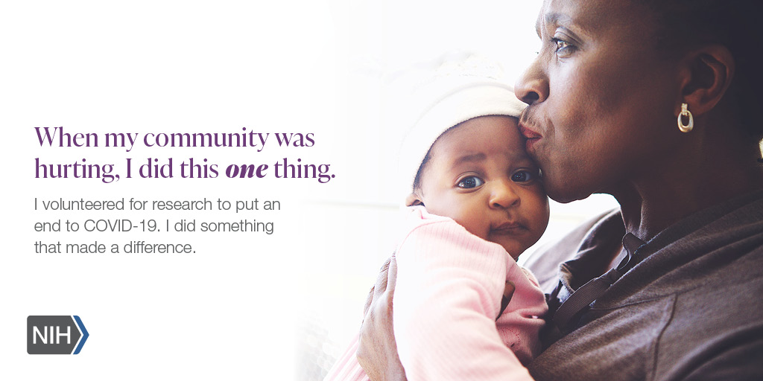
Diversity in Clinical Trials (English)
POST COPY
Facebook
NIH is supporting clinical trials for COVID-19 to identify treatments and vaccines that are safe, effective, and work for the people who need them most. To conquer COVID-19, participation from every community is critical. Learn how your participation in clinical research can make a difference: https://go.usa.gov/xfShb
Twitter
NIH is supporting clinical trials to develop #COVID19 treatments and vaccines that are safe, effective, & work for the people who need them most. To #ConquerCOVID19, participation from every community is critical. Learn more: https://go.usa.gov/xfShb #NIHCEAL
IMAGE OPTIONS
Download Image
Facebook image 1
Twitter image 1
Download Image
Facebook image 2
Twitter image 2

Slide 12
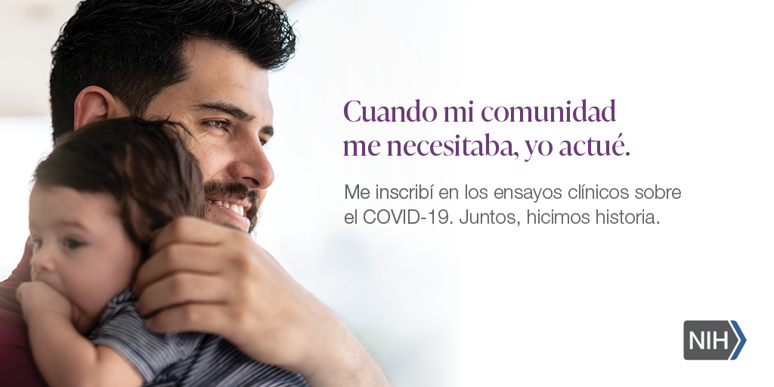
Diversity in Clinical Trials (Spanish)
POST COPY
Facebook
Los NIH están apoyando ensayos clínicos para identificar vacunas y tratamientos contra el COVID-19 que sean seguros, efectivos y que funcionen para las personas que más los necesitan. Para combatir el COVID-19, la participación de todas las comunidades es fundamental. Descubra cómo su participación en la investigación clínica puede hacer la diferencia: https://go.usa.gov/xA6h2
Twitter
Los NIH están apoyando ensayos clínicos para crear tratamientos y vacunas contra el #COVID19 que sean seguros, efectivos y que funcionen para las personas que más los necesitan. Para combatir el COVID19, la participación de todos es fundamental. https://go.usa.gov/xA6h2 #NIHCEAL
IMAGE OPTIONS
Download Image
Facebook image 1
Twitter image 1
Download Image
Facebook image 2
Twitter image 2

Slide 13
Diversity in Clinical Trials (English)
POST COPY
Facebook
Participants in any clinical trial should represent all the people who may use the drug or vaccine being tested. This ensures they are safe and effective for everyone who needs it. Historically, people of color have been underrepresented in clinical research. But your participation can make a difference in the effort to conquer COVID-19: https://go.usa.gov/xA6KV
Twitter
NIH-funded clinical trials are underway to develop #COVID19 treatments and vaccines. These trials must include participation of diverse communities across the country. Learn how your participation can make a difference: https://go.usa.gov/xA6KV #ConquerCOVID #NIHCEAL
IMAGE OPTIONS
Download Image
Facebook image 1
Twitter image 1
Download Image
Facebook image 2
Twitter image 2

Slide 14
Diversity in Clinical Trials (Spanish)
POST COPY
Facebook
Los participantes en cualquier ensayo clínico deben representar a todas las personas que puedan usar el medicamento o la vacuna que se está probando. Esto asegura que la vacuna sea segura y eficaz para todos los que la necesiten. Históricamente, las personas de minorías raciales y étnicas no han tenido suficiente representación en la investigación clínica. Pero su participación puede marcar la diferencia en el esfuerzo por combatir el COVID-19: https://go.usa.gov/xA6h2
Twitter
Es necesaria la inclusión de las comunidades hispanas/latinas en la investigación del #COVID19 para desarrollar vacunas y tratamientos que funcionen para todos. Los ensayos deben ser tan diversos como las personas en riesgo de contraer la enfermedad: https://go.usa.gov/xA6h2
IMAGE OPTIONS
Download Image
Facebook image 1
Twitter image 1
Download Image
Facebook image 2
Twitter image 2

Slide 15
Clinical Trials (English)
POST COPY
Facebook
Curious about how clinical trials work? Learn about the different stages of clinical studies and find more information on COVID-19 clinical trials: https://go.usa.gov/xA6KG
Twitter
Curious about how #ClinicalTrials work? Learn about the different stages of clinical studies and find more information on #COVID19 clinical trials: https://go.usa.gov/xA6KG
IMAGE OPTIONS
Download Image
Facebook image 1
Twitter image 1
Download Image
Facebook image 2
Twitter image 2

Slide 16
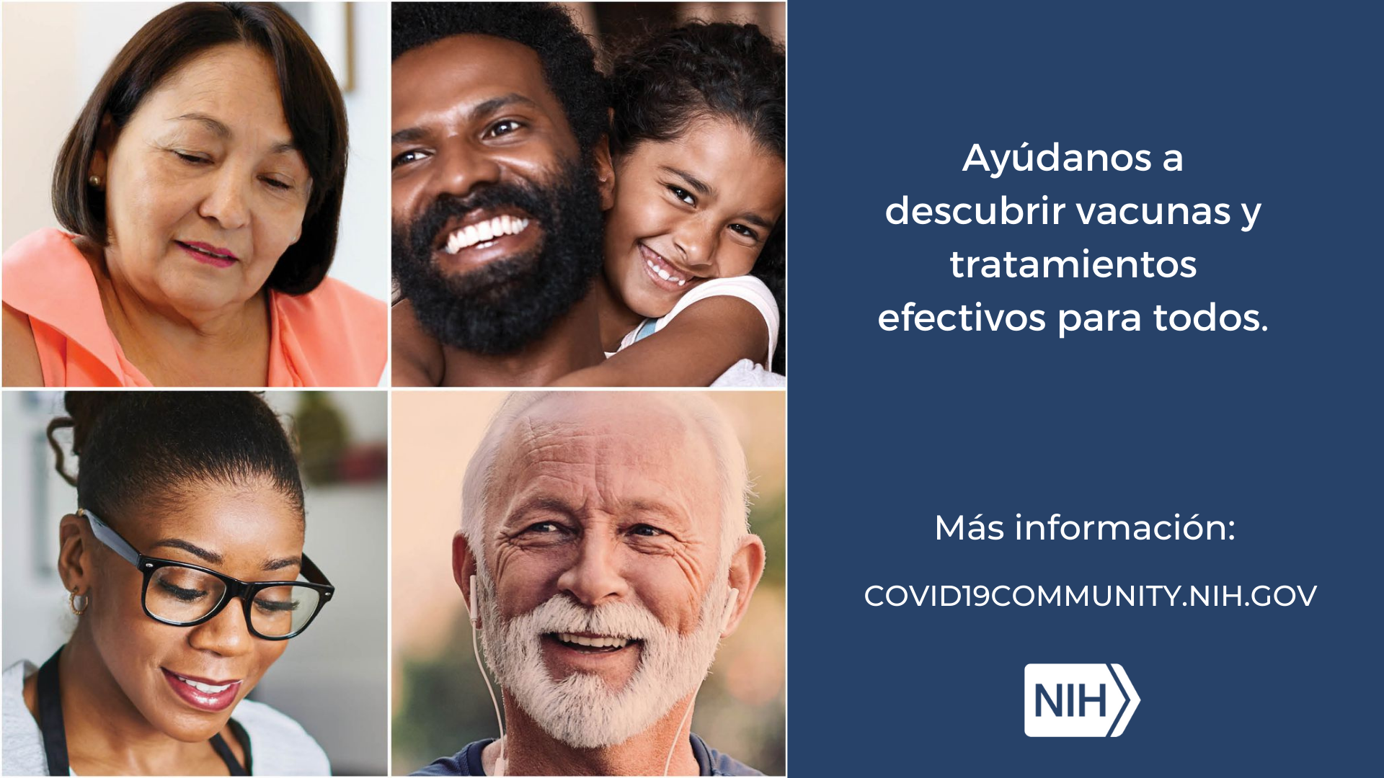
Clinical Trials (Spanish)
POST COPY
Facebook
¿Tiene curiosidad por saber cómo funcionan los ensayos clínicos? Conozca las diferentes etapas de los estudios clínicos para combatir el COVID19 y encuentre más información: https://go.usa.gov/xA6h2
Twitter
¿Tiene curiosidad por saber cómo funcionan los ensayos clínicos? Conozca las diferentes etapas de los estudios clínicos para combatir el #COVID19 y encuentre más información: https://go.usa.gov/xA6h2 #ConquerCOVID19 #NIHCEAL
IMAGE OPTIONS
Download Image
Facebook image 1
Twitter image 1
Download Image
Facebook image 2
Twitter image 2

Slide 17
Educating & Recruiting Clinical Trial Participants
POST COPY
Facebook
English: Are you interested in learning about COVID-19 clinical trials? Find information about the benefits and risks, types of studies, and the processes involved in clinical trials: combatcovid.hhs.gov
Spanish: ¿Está interesado en saber sobre los ensayos clínicos para combatir el COVID-19? Encuentre información sobre los beneficios y riesgos, los tipos de estudios y los procesos involucrados en los ensayos clínicos: combatecovid.hhs.gov/
Twitter
English: Interested in learning about COVID19 clinical trials? Find information about the benefits & risks, types of studies, & the processes involved in clinical trials: combatcovid.hhs.gov #ConquerCOVID19
Spanish: ¿Le interesa saber sobre los ensayos clínicos para combatir el COVID19? Encuentre información sobre los beneficios y riesgos, los tipos de estudios y los procesos involucrados en los ensayos clínicos: combatecovid.hhs.gov/ #ConquerCOVID19
Image of the website will automatically populate because the website URL is included in the copy.

Slide 18
Additional Social Media Content
Additional social media post copy and images are available on the CEAL website and organized by topic.
Ensuring Inclusion
covid19community.nih.gov/resources/ensuring-inclusion
Learning About Vaccines
covid19community.nih.gov/resources/learning-about-vaccines
Understanding Clinical Trials
covid19community.nih.gov/resources/understanding-clinical-trials

